Slide 1
Design Space Exploration of Deep Neural Networks
CSCE 790
By Yang ren, rui xin, Hassan Alamri

Slide 2
Overview
Introduction
Hardware Platform
Models and Datasets
Experiment approach
Some insights
Sampling strategy
Parameters Interaction
Measurement Prediction
Interesting observation
Conclusion

Slide 3
Introduction
Many real-world applications have limitations in hardware resources
Autonomous cars
Mobile devices
We want to explore hardware & compiler-level configurations on DNN models, given constrained hardware resources
How changing in configuration space affects DNNs’ in terms of:
Inference time
Power consumption

Slide 4
Hardware Platform
Nvidia Jetson TX1
Parallel computation
Widely used in deep neural networks applications
Specs:
Maxwell GPU Architecture with 256 CUDA cores
64-bit quad-core ARM A57 CPUs
4GB LPDDR4
16 GB eMMC
Voltage: 5.5 V-19.6 V DC
Maximum module power: 6.5 W-15 W

Slide 5
Models and Datasets
Models
Resnet50 on Keras
VGG16 on Keras -> we observed more memory errors
Datasets
Cifar10 image dataset

Slide 6
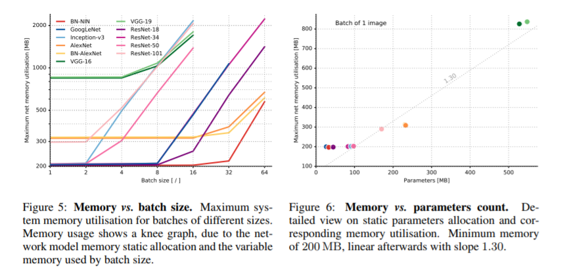
Cont. : Models and Datasets
Reference: https://openreview.net/pdf?id=Bygq-H9eg

Slide 7
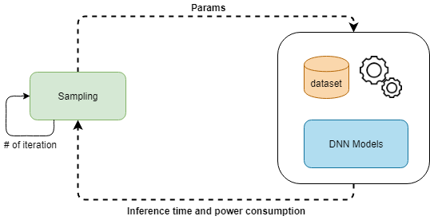
Experiment approach
Experiment using sampling as a client & server as a host for DNNs

Slide 8
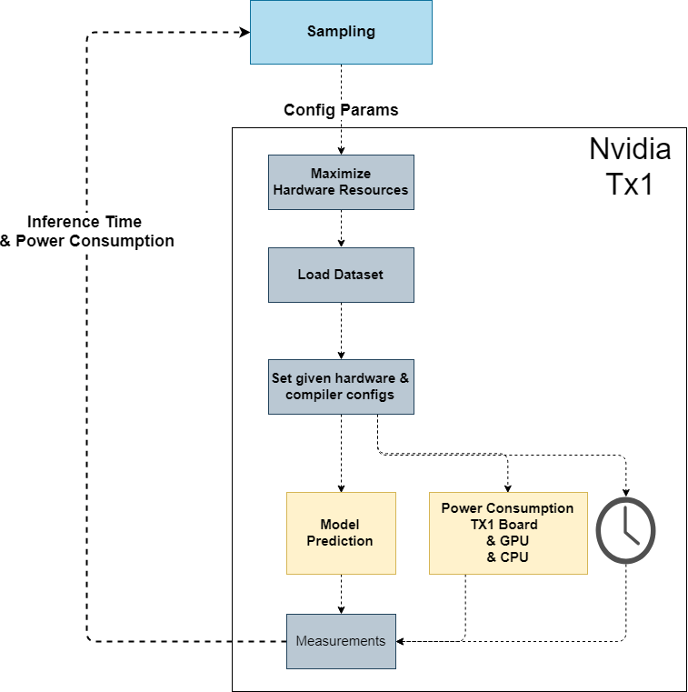
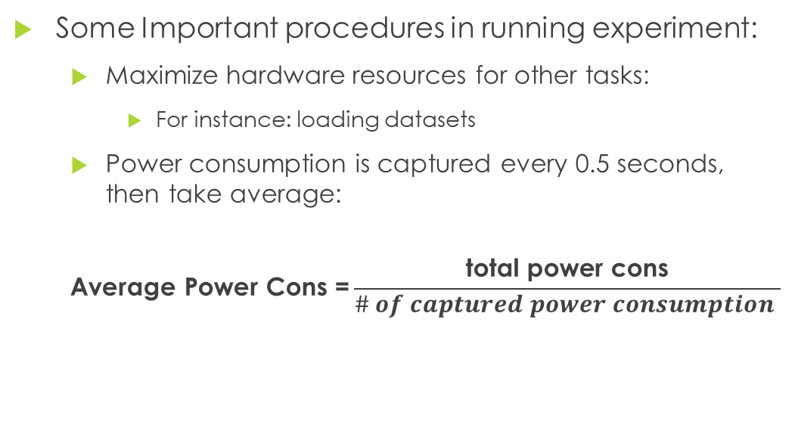
Cont. : Experiment approach
Some Important procedures in running experiment:
Maximize hardware resources for other tasks:
For instance: loading datasets
Power consumption is captured every 0.5 seconds, then take average:
$$\text{Average} \text{Power} \text{Cons}\text{ =}\frac{\text{total} \text{power} \text{cons}}{\# of captured power consumption }$$

Slide 9
Cont. : Experiment approach
Dimension space for our experiments
Hardware Configuration
CPU frequency ~ range between ( 102 MHz , 1.73 GHz )
Number of disabled cores ~ range (0 , 3)
GPU frequency ~ range between (76 MHz , 998 MHz)
EMC frequency ~ range between (80 MHz , 1.6 GHz)
Compiler-level Configuration
Batch Size ~ in range (1, 4, 16, 32)
Allow Growth ~ in range (0 , 1)
Memory fraction per GPU ~ in range (0.15, 0.2, 0.25, 0.3, 0.33)

Slide 10
Some insights
CPU Freq | # disabled cores | GPU freq | EMC freq | Batch Size | Allow Growth | Memory Frac per GPU | Inference Time | Module Power Cons | GPU Power Cons | CPU Power Cons
612 MHz | 2 | 460.8 MHz | 1.33 GHz | 16 | 1 | 0.33 | 24.1s | 4976 | 1391.3 | 368.2
1.326 GHz | 2 | 998.4 MHz | 1.06 GHz | 1 | 0 | 0.15 | 25.5s | 7541.6 | 3688.9 | 630.5
1.224 GHz | 1 | 384 MHz | 1.06 GHz | 32 | 0 | 0.3 | 20.8s | 5623.6 | 1758.2 | 676.5
306 MHz | 3 | 307.2 MHz | 1.6 GHz | 16 | 0 | 0.25 | 38.7s | 4226.2 | 873.2 | 214
1.555 GHz | 3 | 768 MHz | 1.33 GHz | 16 | 0 | 0.25 | 14.5s | 7171.3 | 2828.2 | 893.0
102 MHz | 3 | 307.2 MHz | 1.06 GHz | 32 | 1 | 0.15 | 104.2s | 2872.8 | 339.7 | 82.6
163.2 MHz | 2 | 614.4 MHz | 800 MHz | 1 | 1 | 0.2 | 29.7s | 7376.0 | 3433.3 | 823.8
204 MHz | 0 | 844.8 MHz | 1.6 GHz | 1 | 0 | 0.15 | 54.6s | 4790.6 | 1434.3 | 227.8

Slide 11
Cont. Some insights
Low memory frequency
It works with lowest batch size
Experiment failures
CPU Freq | # disabled cores | GPU freq | EMC freq | Batch Size | Allow Growth | Memory Frac per GPU | Inference Time | Module Power Cons | GPU Power Cons | CPU Power Cons
1.734 GHz | 2 | 998.4 MHz | 4.8 MHz | 32 | 1 | 0.2 | NA | NA | NA | NA
816 MHz | 2 | 460.8 MHz | 4.8 MHz | 32 | 1 | 0.2 | NA | NA | NA | NA
102 MHz | 3 | 76.8 MHz | 4.8 MHz | 32 | 1 | 0.2 | NA | NA | NA | NA
102 MHz | 3 | 76.8 MHz | 4.8 MHz | 1 | 1 | 0.2 | 707.9 | 2598 | 268.2 | 168.7
1.734 GHz | 0 | 998.4 MHz | 1.6 GHz | 32 | 0 | 0.1 |  | NA | NA | NA
1.734 GHz | 0 | 998.4 MHz | 1.6 GHz | 8 | 0 | 0.1 | 10.9 | 9671.7 | 5028.9 | 1098.6
1.734 GHz | 0 | 998.4 MHz | 1.6 GHz | 64 | 1 | 0.1 | NA | NA | NA | NA
Batch size 64 result in failure
Memory fraction works with low batch size

Slide 12
Sampling Strategy
Discretize continuous parameters:
For example:
CPU Frequency = 917 MHz -> Closest(917 MHz) → 918 MHZ
GPU Frequency = 840 MHz -> Closest(840 MHz) → 844.8 MHz
Batch size = 18.222 -> Closest (18.222) → 16
Memory Fraction = 0.2788 -> Closest (2.78888) → 0.3

Slide 13
Cont. : Sampling Strategy
We want to explore configuration space
but, It takes time and effort…. and it costs a lot
For our experiments, for instance:
7 dimensional space, and each has different number of values
Total number of experiments = CPU freq × disabled cores × CPU freq × EMC freq × batch size × growth × memory frac per GPU
Total number of experiments = 18 × 4 × 15 × 4 × 4 × 2 × 6 ≈ 207k
Clearly, that is not practical at all, given the dimension space!

Slide 14
Cont. : Sampling Strategy
We need to tune hyperparameters to minimize both:
Inference time
Power consumption
But, we also want to explore the trade-off…..
Again, to evaluate the objective functions:
A lot of computation and interaction with outside system
Time ~ 5 minutes average
Clearly, the objective functions are expensive to evaluate!

Slide 15
Cont. : Sampling Strategy
We opted to go with Bayesian Optimization (BO), because of:
Black-box optimization
Small number of function evaluations
Exploit regions that yield good points
And explore regions with high uncertainty
With small number of evaluations, it builds an informative model
Based on Gaussian Process (GP)
Uses previously observed parameters to make an assumption about unobserved parameters.
Acquisition Function used to intelligently suggest the next set of parameters

Slide 16
Cont. : Sampling Strategy
Initial Sampling
Latin-Hyper Cube → selection of parameters by even sampling method
Optimization function
Multi-Objectives Bayesian Optimization → Inference and Power Consumption
Hypervolume-based probability of improvement
Focus on density and uniformity of Pareto set
One cost function for multi-objective functions to balance between them

Slide 17
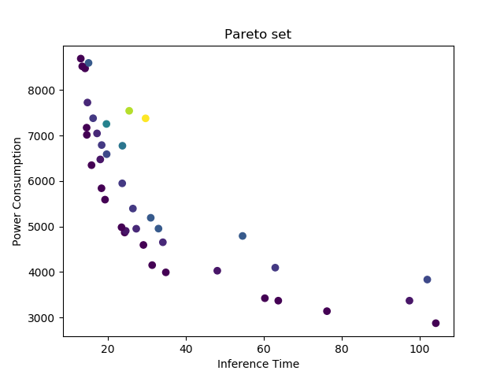


Cont. : Sampling Strategy Resnet50
Using resnet50 model
Bayesian multi-objective approach using GPflowOpt python library
Pareto frontier is the allocation of pareto set efficiency
Potentially optimal points
It enables us to make trade-off
$$f_{max}$$
Pareto Frontier
$$f_{min}$$

Slide 18
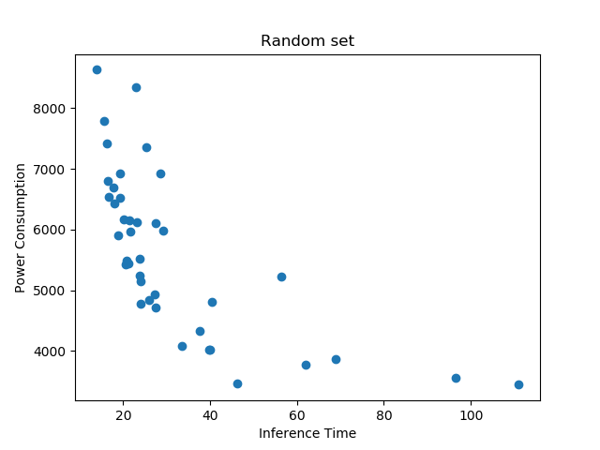
Cont. : Sampling Strategy Resnet50
On Resnet50 model

Slide 19
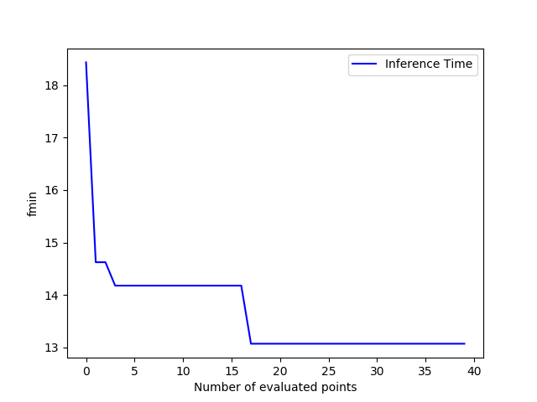
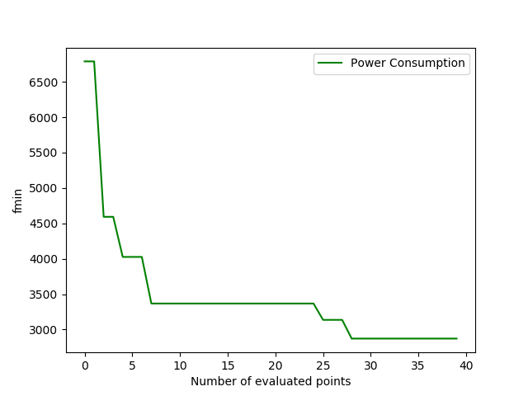
Cont. : Sampling Strategy Resnet50
Bayesian Optimization
We can clearly see the drops in both inference and power consumption
Bayesian optimization starts minimizing the values after 10th evaluated points.

Slide 20

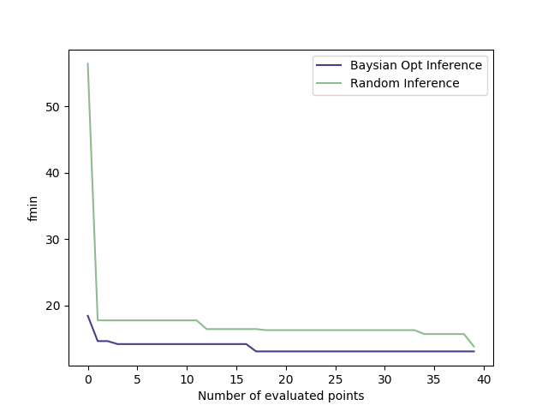
Cont. : Sampling Strategy Resnet50
Comparison between Bayesian optimization and Random Search for evaluated points.
Inference time in Bayesian optimization seems to be dropped earlier than Random Search.

Slide 21
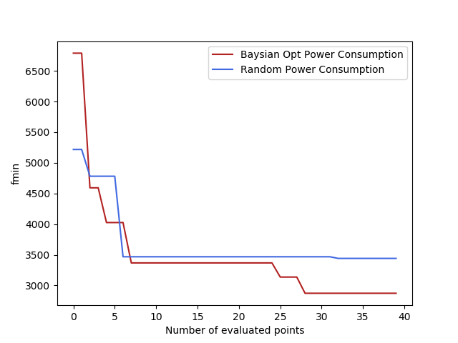
Cont. : Sampling Strategy Resnet50
Comparison between Bayesian optimization and Random Search for evaluated points.
Power consumption in Bayesian optimization drops significantly

Slide 22
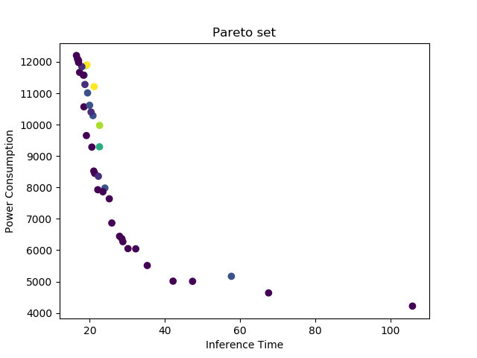
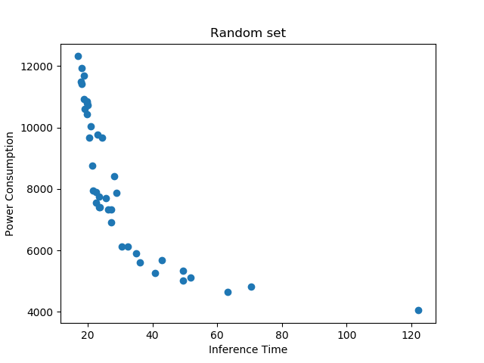
Cont. : Sampling Strategy VGG16
On VGG16 model

Slide 23
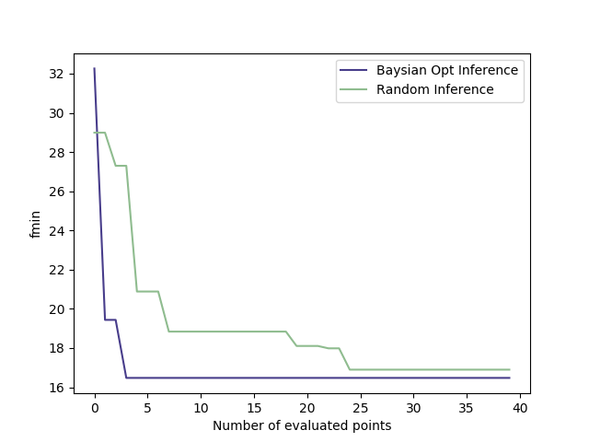
Cont. : Sampling Strategy VGG16
Comparison between Bayesian optimization and Random Search for evaluated points.
Inference time in Bayesian optimization seems to be not dropping.

Slide 24
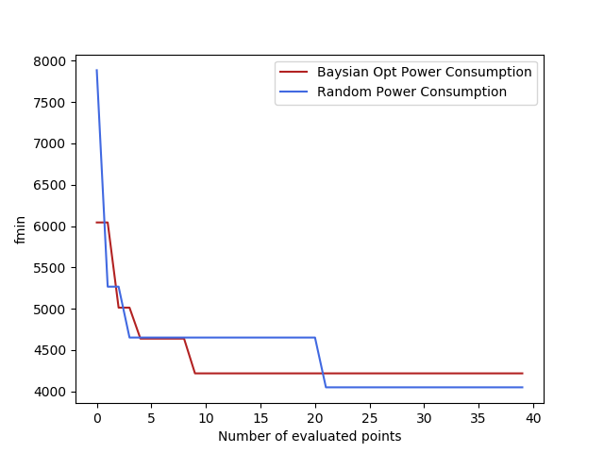
Cont. : Sampling Strategy VGG16
Comparison between Bayesian optimization and Random Search for evaluated points.
Power consumption in random search drops significantly

Slide 25
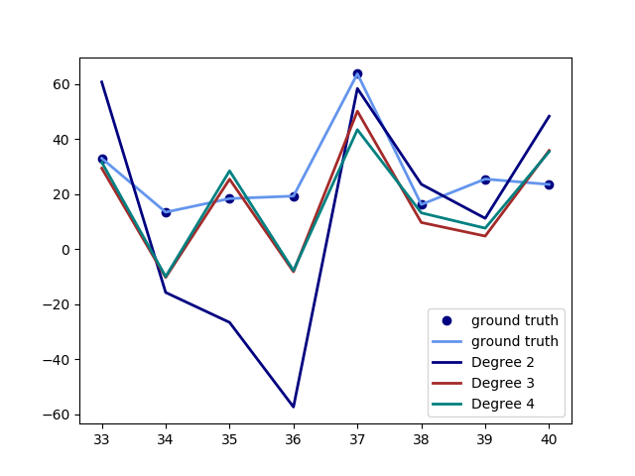
Parameters Interaction Resnet50
Polynomial function for Inference Time with Degree 3 is the best to describe the data and interaction.
Degree 3 is more accurate with lowest RMSE value.

Slide 26
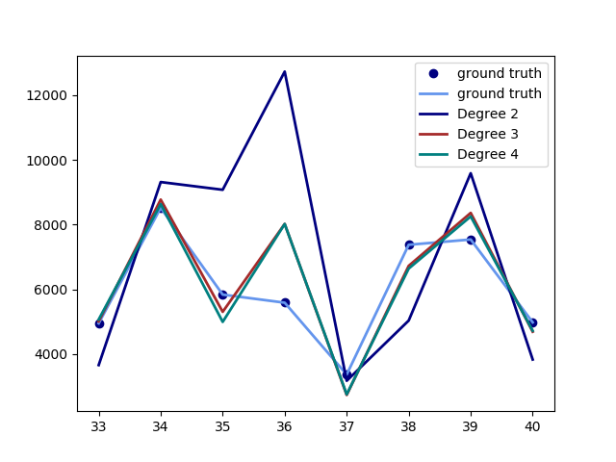
Cont. : Parameters Interaction Resnet50
The same goes for power consumption.
Degree 3 is more accurate with lowest RMSE value.

Slide 27
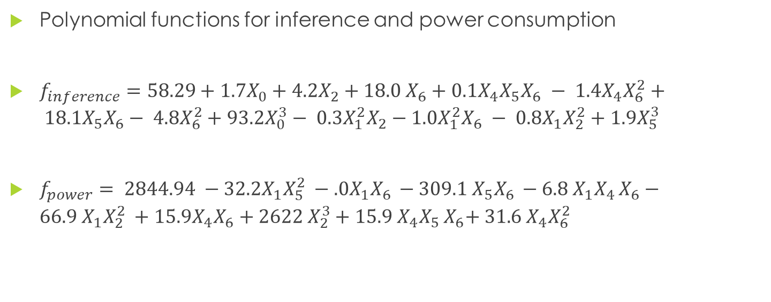
Cont. : Parameters Interaction Resnet50
Polynomial functions for inference and power consumption
$f_{inference}=58.29+1.7X_{0}+4.2X_{2}+18.0 X_{6}+0.1X_{4}X_{5}X_{6} − 1.4X_{4}X_{6}^{2}+ 18.1X_{5}X_{6}− 4.8X_{6}^{2}+93.2X_{0}^{3}− 0.3X_{1}^{2}X_{2}−1.0X_{1}^{2}X_{6} − 0.8X_{1}X_{2}^{2}+1.9X_{5}^{3}$
$f_{power}= 2844.94 −32.2X_{1}{X_{5}^{2}}_{ }−.0X_{1}X_{6 }−\text{309.1}{ X}_{5}X_{6 }−6.8{ X}_{1}X_{4 }X_{6}\text{ − 66.9}{ X}_{1}{X_{2}^{2}}_{ }+\text{15.9}X_{4}X_{6}\text{ + 2622}{ X}_{2}^{3}+15.9 X_{4}X_{5 }X_{6}\text{+ 31.6}{ X}_{4}{X_{6}^{2}}_{ }$

Slide 28
Cont. : Parameters Interaction
We empirically observed that data obtained from Bayesian Optimization on Resnet50 have roughly lowest RMSE, and more accurate for predication.
Meanwhile, data obtained from Random search on VGG16 have roughly lowest RMSE, and more accurate for predication.
But, we are still curious and need another evidence……
Gradient Boosting Regression
Ensembling technique
Uses a set of predictors to yields better results
Controls the variance of a model to build a complex predictive function

Slide 29
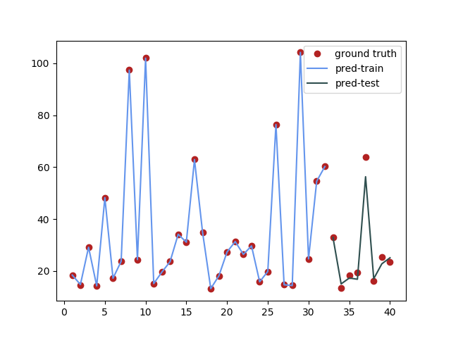
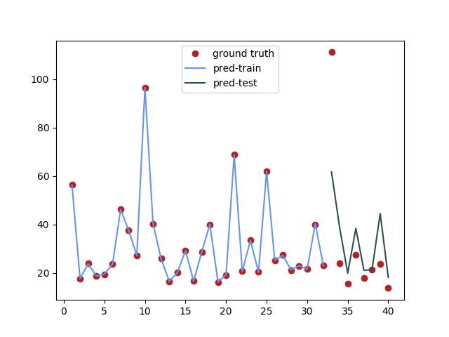
Cont. : Measurement Prediction Resnet50
Bayesian Optimization
Random
RMSE: 3.08
RMSE: 20.16

Slide 30
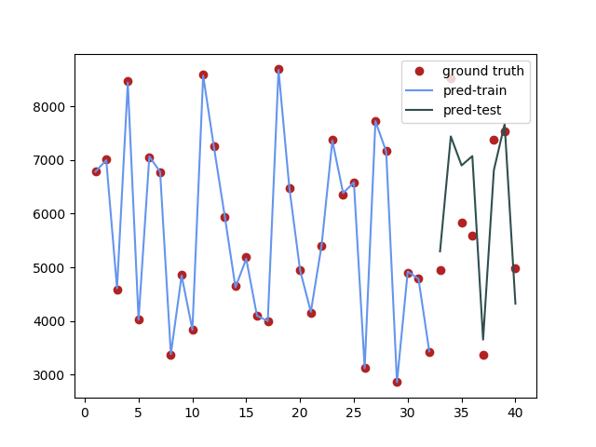
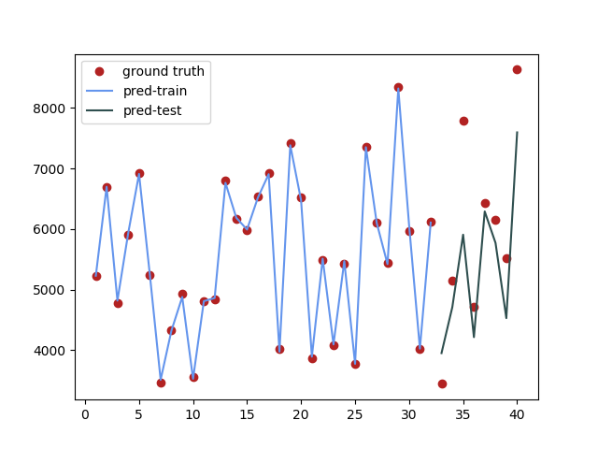
Cont. : Measurement Prediction Resnet50
Bayesian Optimization
Random
RMSE: 826.34
RMSE: 897.15

Slide 31
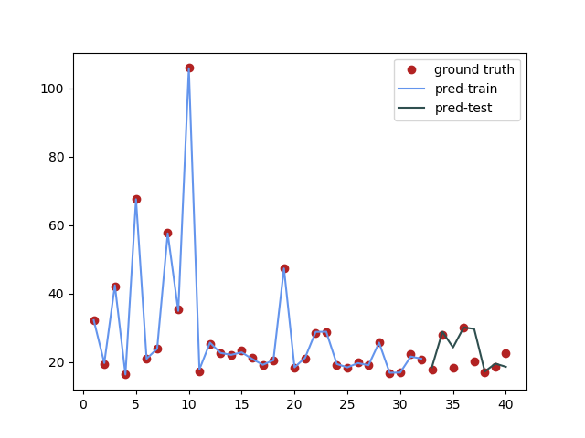
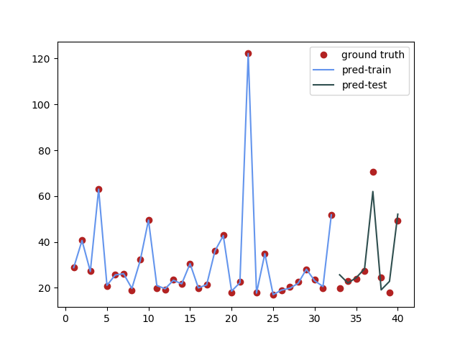
Cont. : Measurement Prediction VDD16
Bayesian Optimization
Random
RMSE: 4.2
RMSE: 4.5

Slide 32
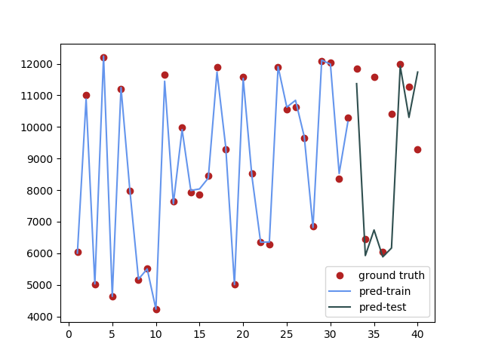
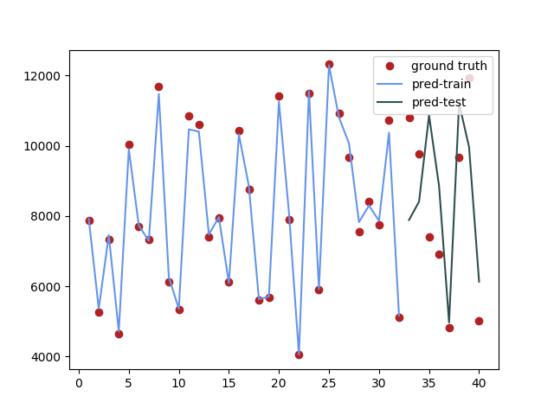
Cont. : Measurement Prediction VDD16
Bayesian Optimization
Random
RMSE: 2470.6
RMSE: 2052.4

Slide 33
Interesting observation
Slight changes in probability
Image classification by Resnet50
Configuration 1
Configuration 2
Configuration 3
Label | Probability
hartebeest | 0.8069511
sunscreen | 0.27676105
chain_saw | 0.6491425
Japanese_spaniel | 0.22487636
Label | Probability
hartebeest | 0.80695164
sunscreen | 0.27676108
chain_saw | 0.64914304
Japanese_spaniel | 0.22487622
Label | Probability
hartebeest | 0.80695087
sunscreen | 0.27676052
chain_saw | 0.6491422
Japanese_spaniel | 0.22487634

Slide 34
Conclusion
Resnet50 & VGG16 with 100 images from Cifar10 dataset used for experiments
We show the advantage of using Bayesian Optimization to tune hyperparameters in both Resnet50 & VGG16
Surprisingly, Random search seems to be better in VGG16
We show the interaction of parameters using polynomial functions.
We also present another model for prediction
If we have time:
Handle missing values in Bayesian Optimization
Experiments with different models and datasets
Explore the accuracy of image classification given the configuration space

Slide 35
THANK YOU ☺

